Slide 1
Prototyping, engineering and design

Slide 2
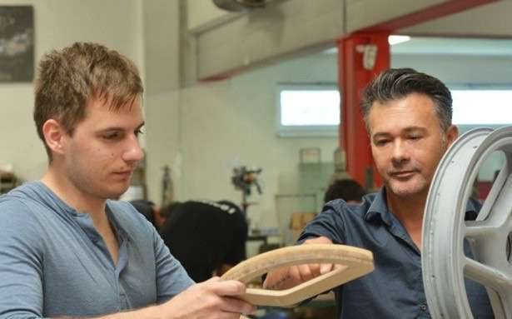

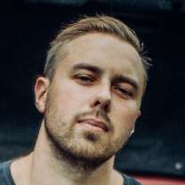
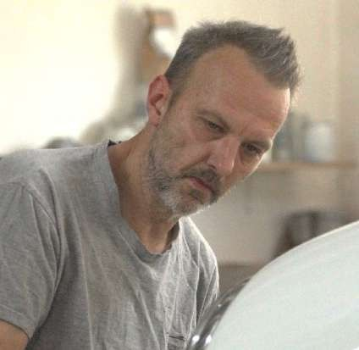




Luka Jelaska Autocad and 3D solidworks designer
Asbjoerk Mogensen Design Director COO and Part owner
Ivan Zhurba Designer
CUSTOM CREATIONS own prototype department in Croatia,
- a company based in Zagreb, Croatia. With over 20 years of
experience in prototyping from show cars over electric motor cycles, Electric scooters and electric bicycles to specific parts of robotics machine. Currently 8 employees in production
and two engineers for CAD drawings, makes Custom creations a very reliable partner for prototyping .
Full engineering team for electric vehicles
Some of technic we use are:
CNC milling
3D printing
Tooling production (aluminium, NECUMER)
RTM process ( carbon fiber)
Vacum infusion (carbon fiber )
Autoclave process ( carbon fiber, partner)
Glass fiber molds
Own Autoclave oven
Founder and Ceo and Sasa Stih

Slide 3















Awards
1 x Runner up A Awards
4 x Universal Design Awards 6 x European design Award
6 x International design award 2x Bicycle brand Contest
16 x Eurobike Awards
3x Taipei Cycle d&i GOLD awards 14 x Taipei Cycle d&i awards
3 x E-bike of the year (2017 & 2018 & 2019)
6 x Nomination designer of the year by IAD (2017,2018,2019, 2020 & 2021, 2022)
6 x Nomination designer of the year by EPDA (2017,2018,2019 & 2020, 2021, 2022) 6 x Winner Bicycle Brand Contest
3 X Clio Awards
3 x Mobius Awards
3 x Cannes Lions Awards 6 x Creative Circle Awards
1 X Designer of the year New York design awards 1 x Good design Award Australia
1 x designer of the year USA 6 x Creative Circle
WINNER OF:
1 x Muse design Award GOLD 4 x IF Awards
4 x Red Dot design Awards 16 x German Design Awards 3 x German Innovation Award
2 x German Brand Awareness Award
1 x German Automotive Brand Contest 3x German Bicycle brand contest
22 x A' Design Award
4 x Platinum A Awards 6 x Gold A Awards
4 x Silver A Awards 2 x Bronze A Awards 1 x Iron A Awards
1 x Muse Awards
1 x New York design awards 1 x Ikea award

Slide 4
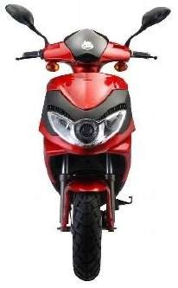
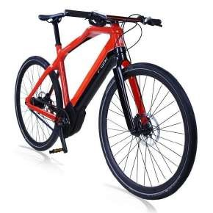
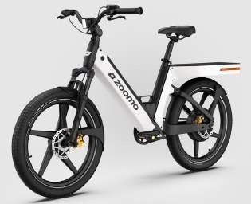
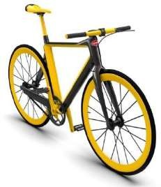
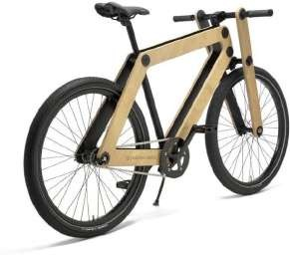
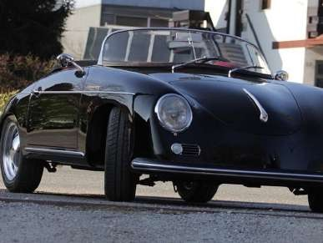
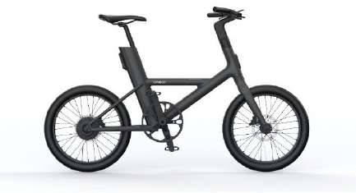
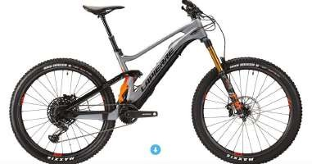
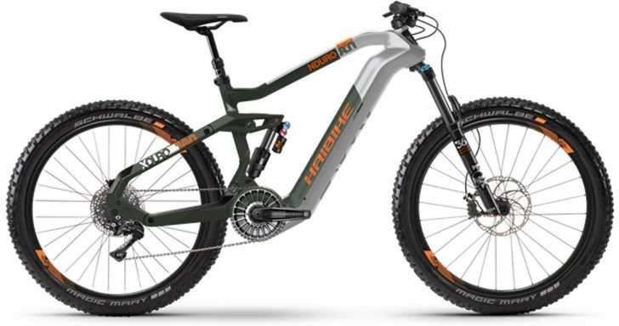
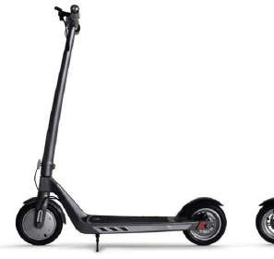
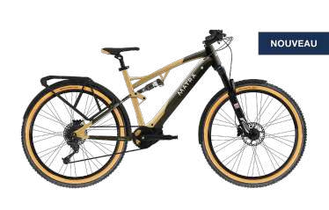
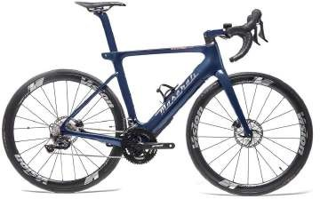
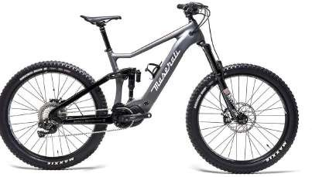
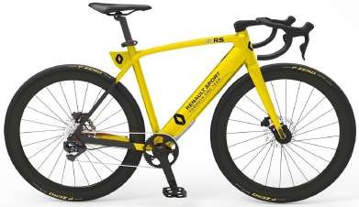
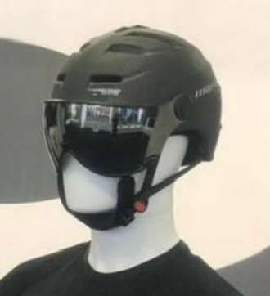
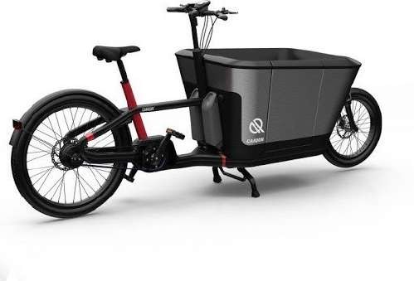
Sni plus d.o.o / Marijana Stilinovića 55a / 10431 Sveta Nedelja / Croatia

Slide 5
Client list
IKEA
Pininfarina Evoluzione
Maserati
Jeep
Kawasaki
Bugatti
Mercedes
Renault
Mini Cooper
Ferrari
Pagani
Haibike
Raleigh
Ghost
Winora
Sparta
Mahindra
Brose
Schwinn
Merida
Zeitgeist Motors
Panasonic
Harley Davidson
Lapierre
Cowboy
Nishiki
Winther
COOP
Biltema
Thansen
Matra
Velo Solex
Easybike
Dott
Circ
Okai
Jump
Diavelo
Bafang Motors
Bosch Motors
KOGA
Lamborghini
enViolo
GT
Copenhagen University
Accell Group Innovation
Kawasaki
BMW
Haibike
Van Moof
VW
FALCO Motors
Matra Motors
Babboe
CarQon
Carver car NL
Decathlon
Lapierre
N+Bikes
Batavus
DiamondBack
AutoNord
Verlinvest (Cowboy)
DS automobile
N+Bikes
Mongoose
Ebike4delivery
REI
Bycyklen Copenhagen
Solex
Matra Cars
Buyk
Hopr
BMC
Chaos
Ernie Kusters
Aston Martin
Accell Group
Brose
Tour De France org
Cycle Europe
Sachsenring
Pantone
Cannondale
Ebike Labs
Swiss emobility Group
M-Way
Colag
Elektrofahhrad einfach
Mifa
Lapierre
Bodo bicycle factory
Hercules (ZEG)
Stella
Brose Motors
Segway
Citroen
Smafo
BODO
Stajvelo
Sni plus d.o.o / Marijana Stilinovića 55a / 10431 Sveta Nedelja / Croatia

Slide 6

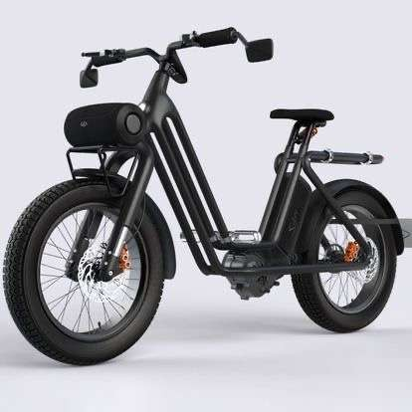
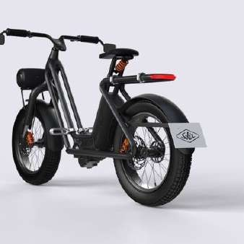
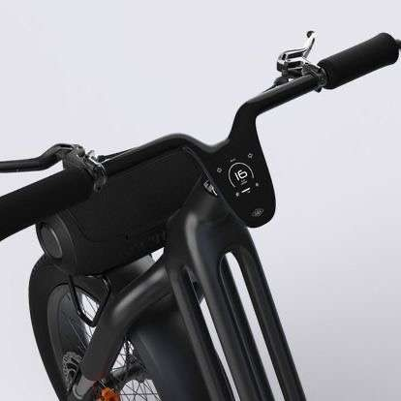
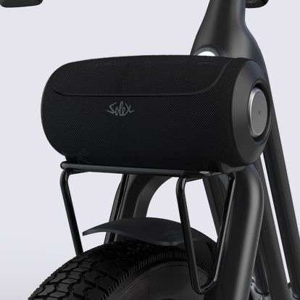

Slide 7

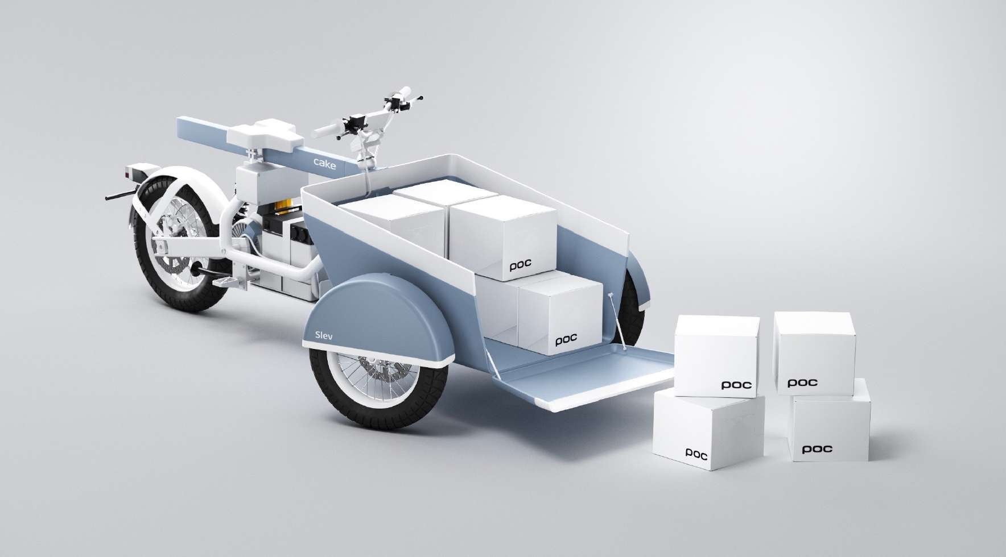

Slide 8
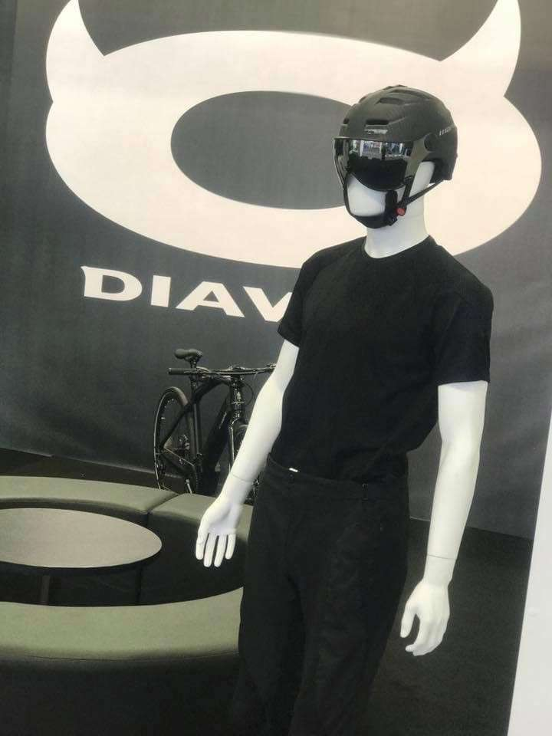
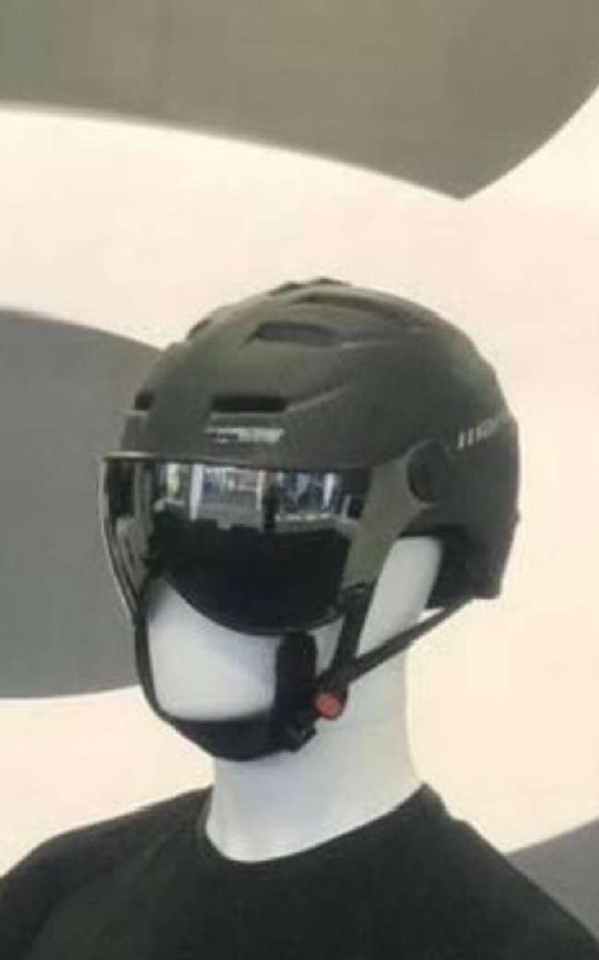

Slide 9

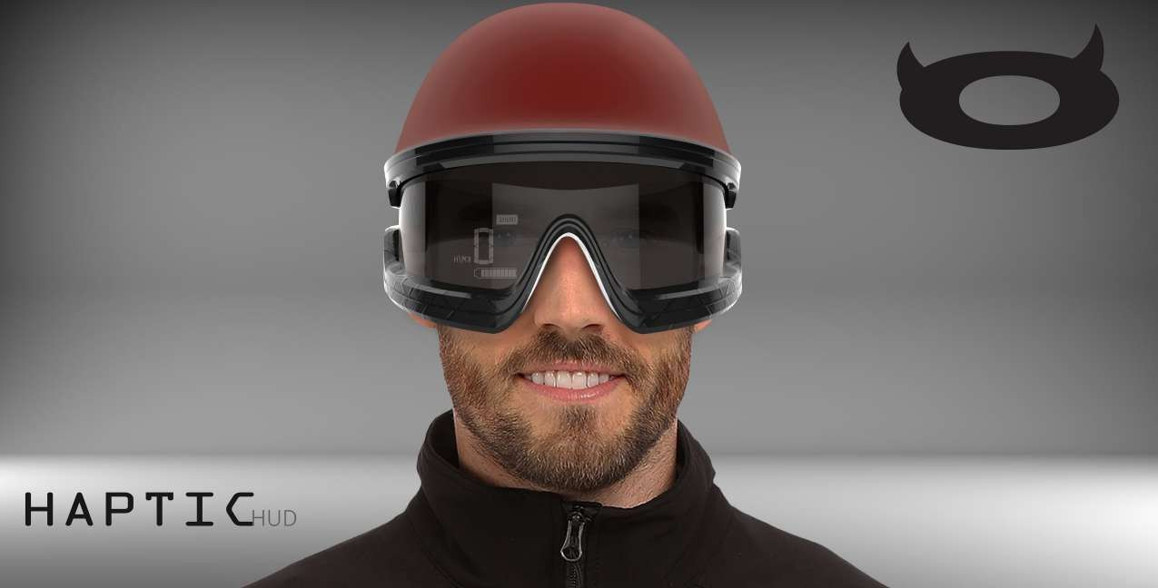
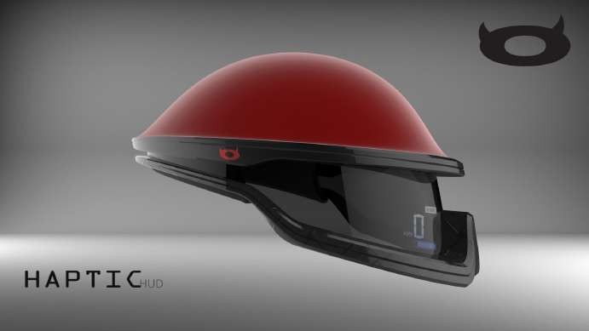
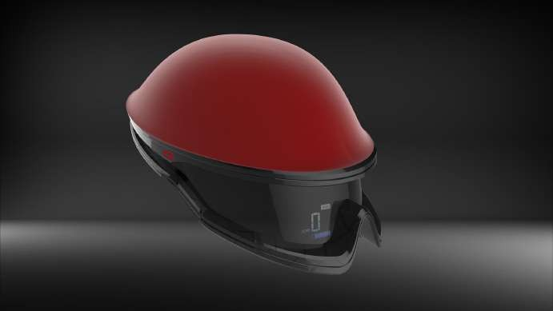
Sni plus d.o.o / Marijana Stilinovića 55a / 10431 Sveta Nedelja / Croatia

Slide 10

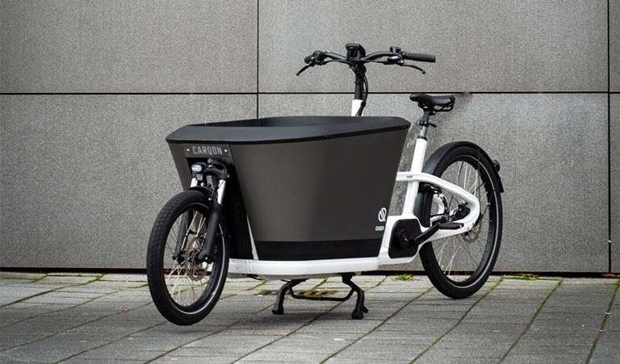

Slide 11
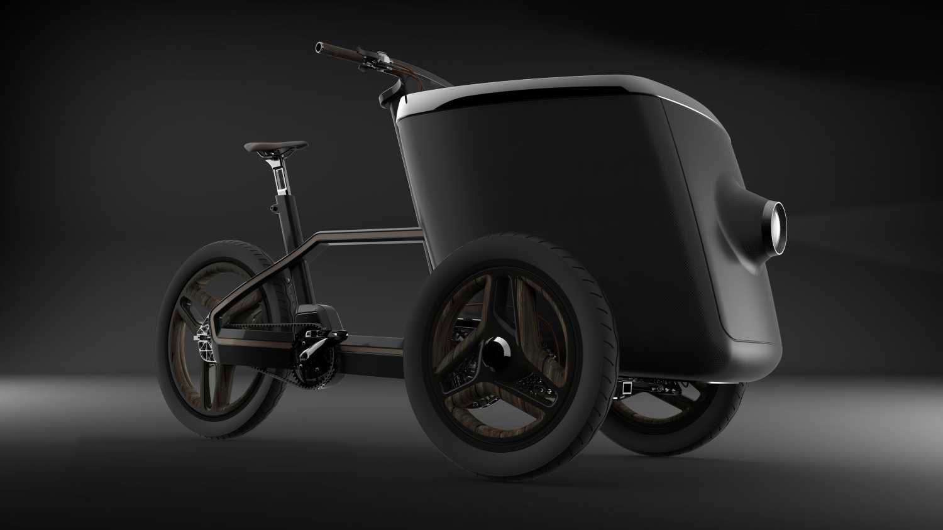

Slide 12
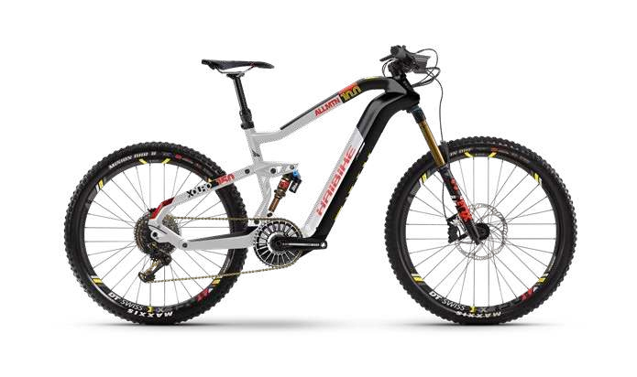

The HAIBIKE Flyon
Sni plus d.o.o / Marijana Stilinovića 55a / 10431 Sveta Nedelja / Croatia

Slide 13
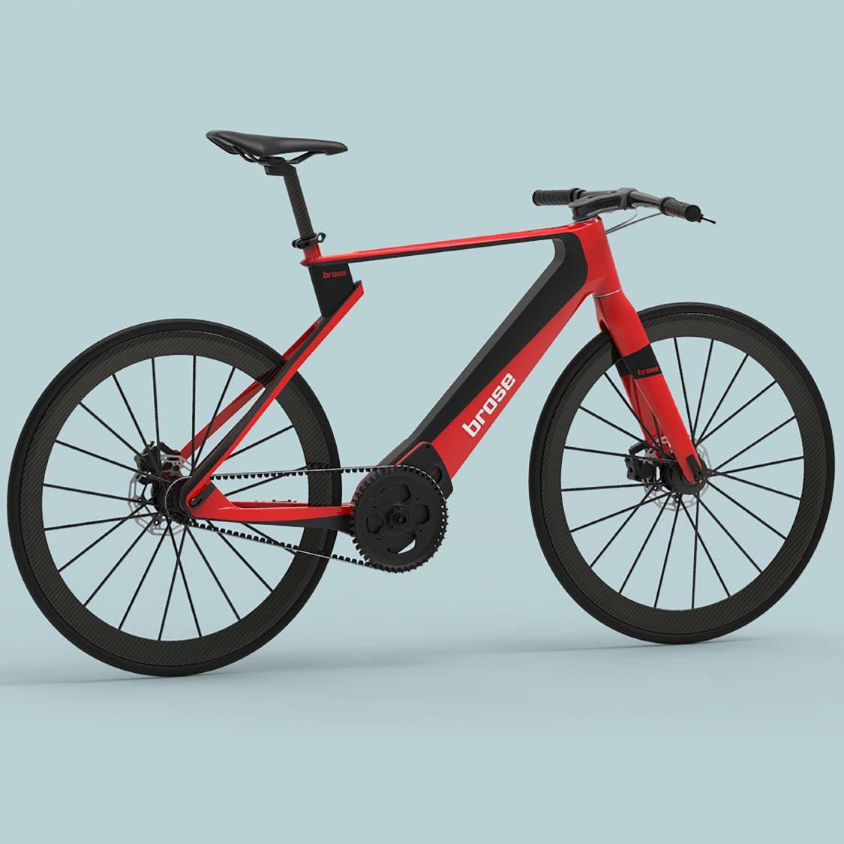

The HAIBIKE Flyon
Sni plus d.o.o / Marijana Stilinovića 55a / 10431 Sveta Nedelja / Croatia

Slide 14

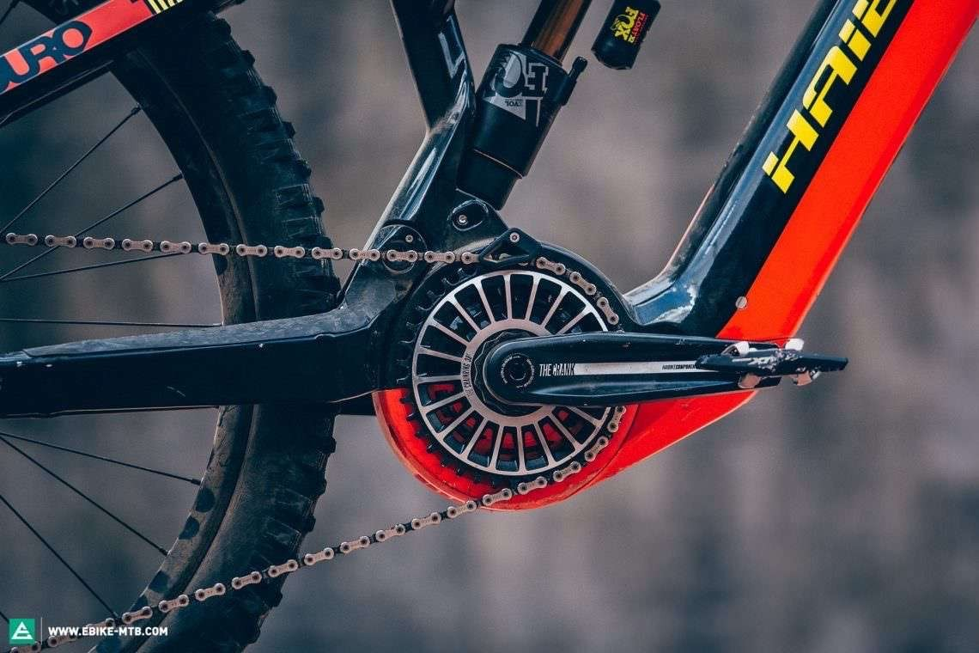
The HAIBIKE Flyon TQ Motor
Sni plus d.o.o / Marijana Stilinovića 55a / 10431 Sveta Nedelja / Croatia

Slide 15
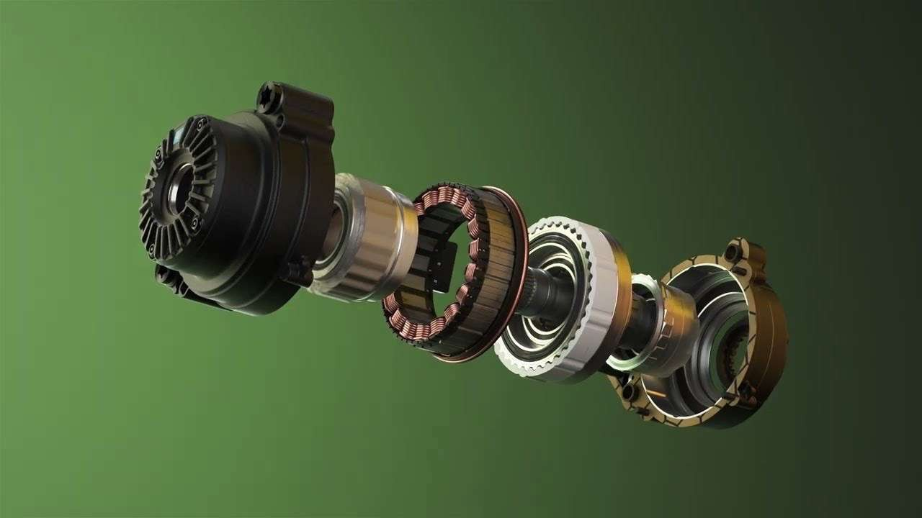
The TQ Motor – we made it work. !!!
Sni plus d.o.o / Marijana Stilinovića 55a / 10431 Sveta Nedelja / Croatia

Slide 16

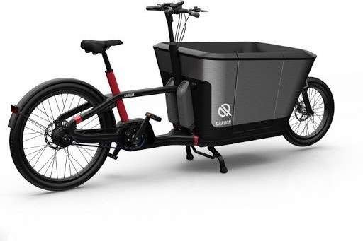
The carQon
Sni plus d.o.o / Marijana Stilinovića 55a / 10431 Sveta Nedelja / Croatia

Slide 17

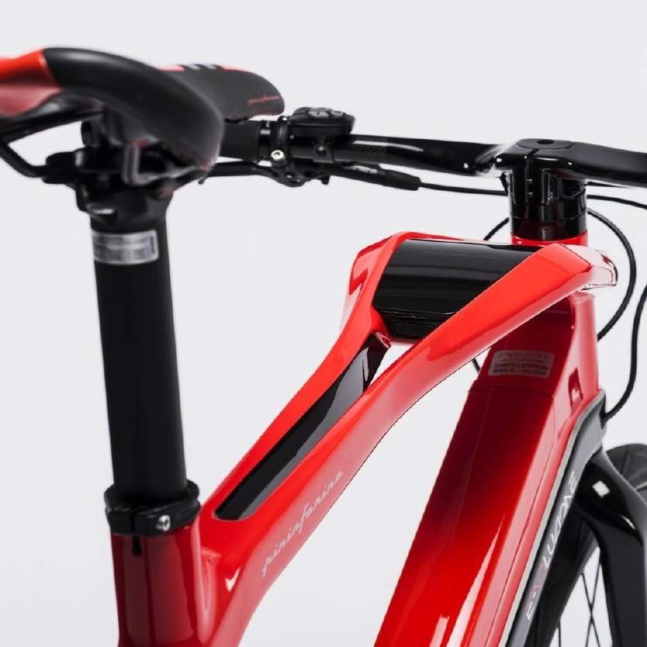
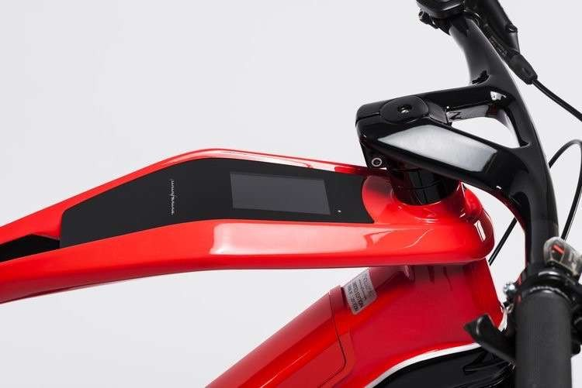
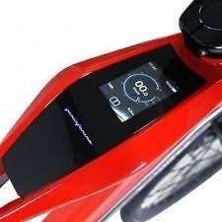
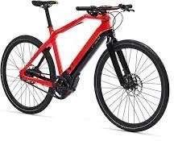
The Pininfarina Evoluzione
Sni plus d.o.o / Marijana Stilinovića 55a / 10431 Sveta Nedelja / Croatia

Slide 18

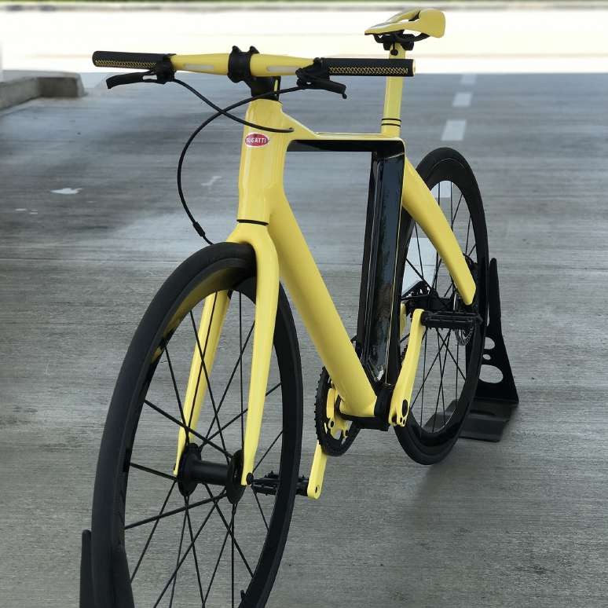
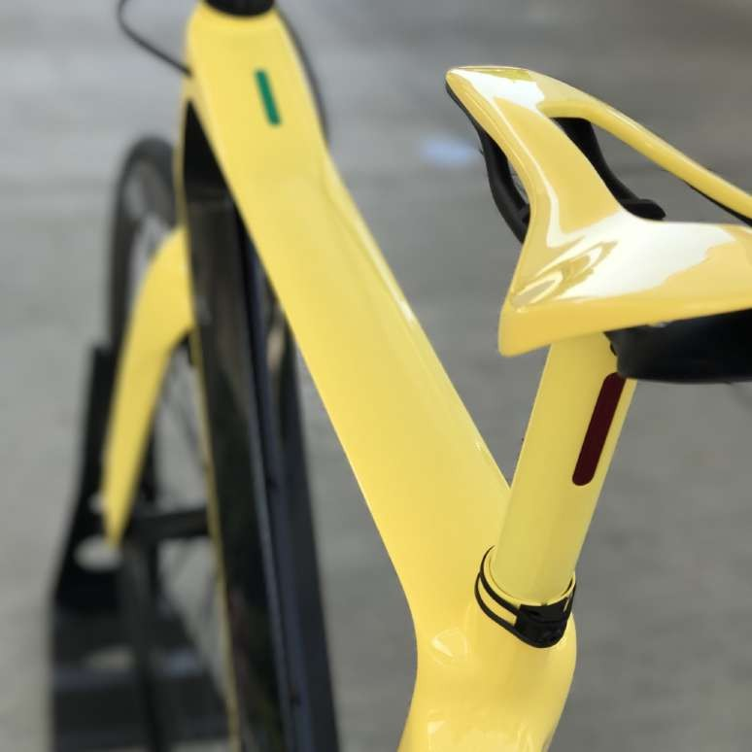
The Bugatti e-bike
Sni plus d.o.o / Marijana Stilinovića 55a / 10431 Sveta Nedelja / Croatia

Slide 19
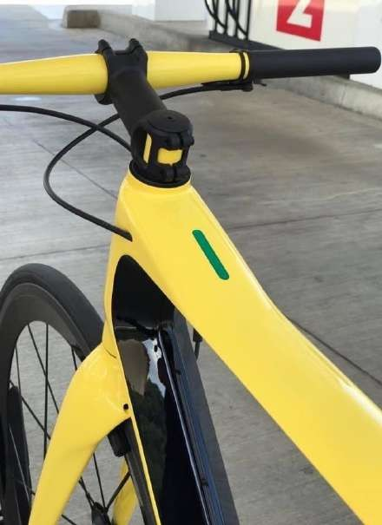
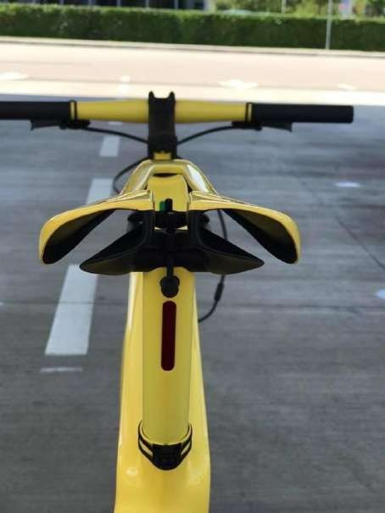
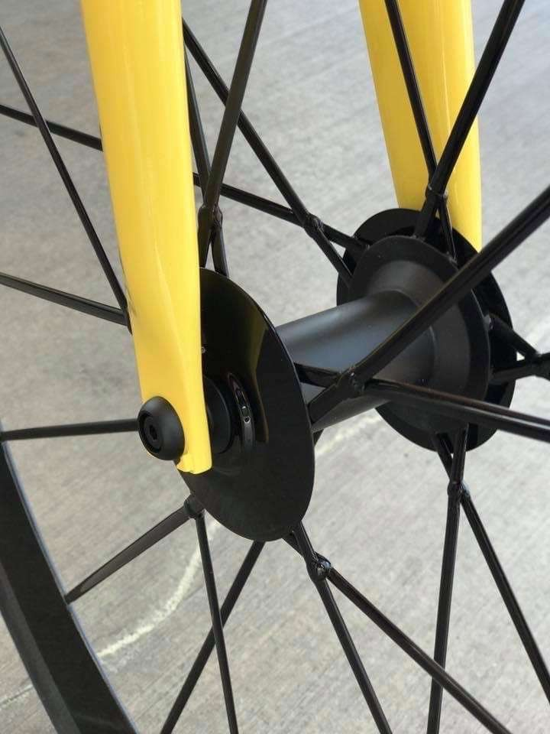
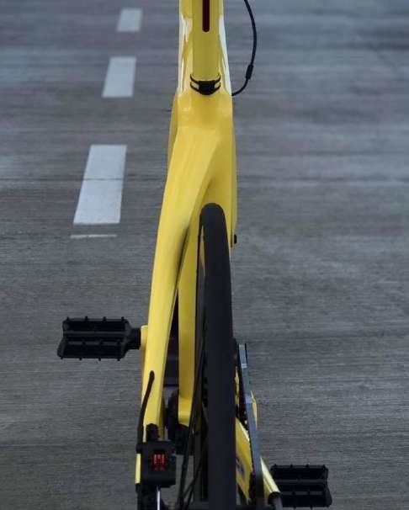
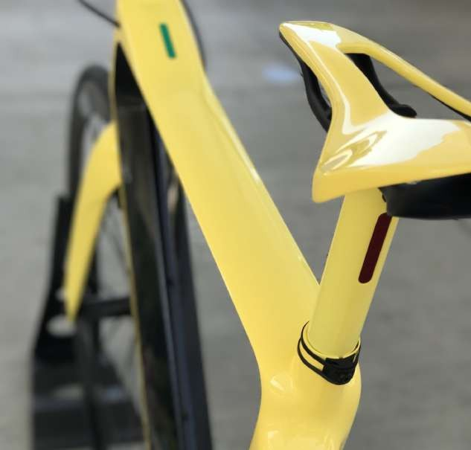
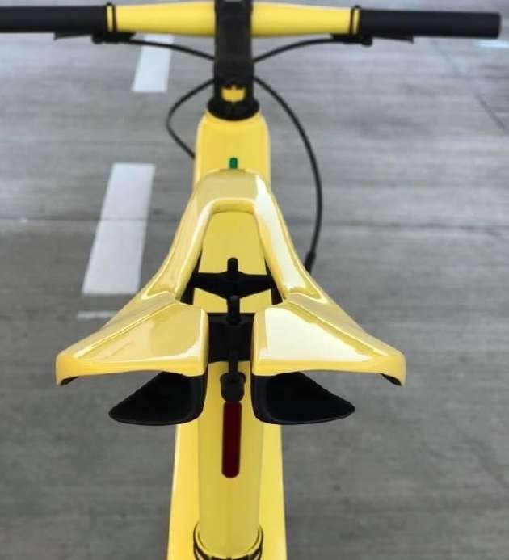
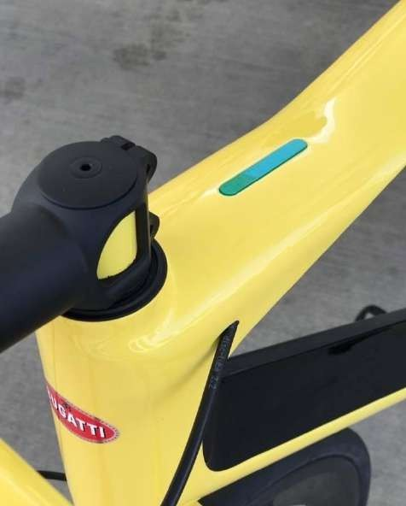
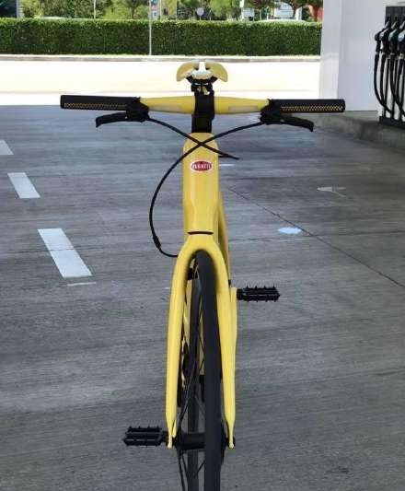


Slide 20






Maserati e-scooter

Slide 21





Chaos e-motorcycle

Slide 22



Chaos e-motorcycle

Slide 23

Chaos e-motorcycle

Slide 24



The Lynx GT electric 2 x 550 Hp Fukuta motors
Sni plus d.o.o / Marijana Stilinovića 55a / 10431 Sveta Nedelja / Croatia

Slide 25


The Lynx Nanoq Electric 165 Hp version
Sni plus d.o.o / Marijana Stilinovića 55a / 10431 Sveta Nedelja / Croatia

Slide 26


Porsche 356 in carbon fibre made by
Sni plus d.o.o / Marijana Stilinovića 55a / 10431 Sveta Nedelja / Croatia

Slide 27

Tedson Porsche made by
Sni plus d.o.o / Marijana Stilinovića 55a / 10431 Sveta Nedelja / Croatia

Slide 28

Tedson Porsche made by
Sni plus d.o.o / Marijana Stilinovića 55a / 10431 Sveta Nedelja / Croatia

Slide 29

Tedson Porsche Safari replica made by
Sni plus d.o.o / Marijana Stilinovića 55a / 10431 Sveta Nedelja / Croatia

Slide 30

Tedson Porsche Safari replica made by
Sni plus d.o.o / Marijana Stilinovića 55a / 10431 Sveta Nedelja / Croatia

Slide 31

Tedson Porsche Safari replica made by
Sni plus d.o.o / Marijana Stilinovića 55a / 10431 Sveta Nedelja / Croatia

Slide 32



Electric Carver made by

Slide 33

Electric Carver made by

Slide 34



Autonomous Docking Truck made by
Sni plus d.o.o / Marijana Stilinovića 55a / 10431 Sveta Nedelja / Croatia

Slide 35


Docking 3 Seater car made by
Sni plus d.o.o / Marijana Stilinovića 55a / 10431 Sveta Nedelja / Croatia

Slide 36


Panasonic autonomous cabin made by
Sni plus d.o.o / Marijana Stilinovića 55a / 10431 Sveta Nedelja / Croatia

Slide 37


Slide 38



Slide 39


Slide 40


Slide 41



Slide 42



DO ł’J’T ž3Ef’J D A MA ł’J TD DO A P IAC H IPdE'ž C0 Ø

Slide 43



Slide 44



Slide 45


Slide 46


Slide 47


Slide 48


Slide 49


Slide 50


Slide 51


Slide 52


Slide 53


Slide 54


Slide 55


Slide 56


LASTMILE TOWARDSTHE FUTURE
LAST MILE
We aim to tackle the modern era obstacles of personal transportation in urban areas.
As an appropriate direction for the future, we see the micromobility concept.

Slide 57
In our series of micromobility solutions, we chose to start this journey by designing an
ELECTRIC SCOOTER

Slide 58

THEMOST POPULARCHOICE
Since its entry into the consumer markets, the electric scooter has been rapidly adopted by the users as the viable option to replace cars and public transportation in urban areas.
That was six years ago.

